Slide 1
Adaptive Motor Monitoring System Based on Machine Learning Batch Training
Design Review #4
Team 17
Group Member:
Zhang Ting;Cheng Yiwei;
Zhou Chenxin;Zhu Junru;
Company Sponsor: CyberInsight
Company Mentor: Fang Chen
Wentao Li
Project Instructor: Prof. Ma Chengbin
Presented by VE450 Team 17 Dec 12. 2018

Slide 2

Introduction
Customer Need and Engineering Specifications
Concept Generation and Selection
Description of Final Design
Prototype Description
Test and Parameter Analysis
Discussion and Conclusion
Contents
Presented by VE450 Team 17 Dec 12. 2018

Slide 3

Review of Problem
Traditional motor health monitoring system: Cloud One-Time Training
Cloud training
Problem: low-efficiency; Easy to lose datum
One-time training
Problem: Non-adaptive;
Cloud
Normal
Data Behavior
Most Recent
Data
Behavior
An industrial motor
One-time model
In the cloud: Compare the recent data with the one-time model
Figure 1: Flow chart of cloud one-time training Model
* Figure 1 from Wikipedia (Electronic Motor)
Presented by VE450 Team 17 Dec 12. 2018

Slide 4


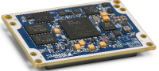
Possible Solution
Our motor health monitoring system: Edge Batch Training Model
Edge Computing
Advantage: Guarantee efficiency
Batch Training
Advantage: Adaptive to different batches of motors
An industrial motor
Batch Training Model embedded on Edge End
Viewable Web-UI interface
Figure 2: Flow chart of Edge Batch Training Model
* Figure 1 from Wikipedia (Electronic Motor)
Presented by VE450 Team 17 Dec 12. 2018

Slide 5
Customer Need & Engineering Specifications
- An adaptive motor monitoring system based on edge batch training
Customer Need | Engineering Specification
Efficiency to train the model | Training Rate > 50 datum/s Response Time < 200ms with 0 loss
Adaptivity to different kinds of motors | The system can be trained to detect > 1 motors
High accuracy | Accuracy > 95 %
Remote Control | Supported Operations: Train, Stop, Retrain
A Web user interface Know the health condition of the motor Know the train process Know the historical condition as reference | Show 1. the real-time train process 2. the detected health score 3. the historical data
Table 1: Customer Need & Engineering Specification
Presented by VE450 Team 17 Dec 12. 2018
Notes:
????????buhui

Slide 6
Flow Chart for the Conceptual Design
Vibration on x, y axis ,Rotation Speed
Hardware System: An edge computing node
An industrial motor
Data Acquisition
(DAQ)
Platform
Web UI
Software System
Batch training Motor Monitoring Algorithm
Proper quantity
Indicating the health of motor
Web UI services
An adaptive model
Figure 3: Morphological analysis of the project
Presented by VE450 Team 17 Dec 12. 2018
Notes:
Hardware说法好还是edge。。好

Slide 7
Concept Generation
Categories of Concept # | Platform | Batch training motor Monitoring system | Web UI services
1 | Raspberry Pi | Incremental Principal Component Analysis [3] +Q-statistic (IPCA+Q) | Flask
2 | Arduino | Simple Principal Component Analysis [4] +Q-statistic (SPCA+Q) | Django
3 | PC | Self Organizing Map [5] +Minimal Quantization Error Statistic (SOM+MQE)
4 |  | Gaussian mixture method [6] + Covariance Validation (GMM+CV)
Table 2. Design Concepts
Presented by VE450 Team 17 Dec 12. 2018

Slide 8
Platform
Design Criteria | Weighing Factor | Raspberry PI (0-10) | Arduino (0-10) | PC (0-10)
Low latency | 0.1 | 8 | 6 | 10
Portability | 0.1 | 10 | 10 | 2
Stability | 0.2 | 8 | 7 | 10
Low memory cost | 0.2 | 8 | 9 | 1
Computational Power | 0.4 | 9 | 4 | 10
Score | 1 | 8.6 | 6.4 | 7.3
Table 2. Selection for the platform

Slide 9
Batch Training Motor Monitoring Algorithm
Design Criteria | Weighing Factor | IPCA+Q[3] (0-10) | SPCA+Q[4] (0-10) | SOM+MQE[5] (0-10) | GMM+CV[6] (0-10)
Adaptivity | 0.3 | 8 | 7 | 9 | 5
Speed | 0.2 | 8 | 7 | 9 | 7
Accuracy | 0.2 | 9 | 9 | 8 | 7
Algorithm Complexity | 0.1 | 6 | 6 | 7 | 6
Memory | 0.2 | 8 | 6 | 9 | 7
Score | 1 | 8 | 7.1 | 8.6 | 6.3
Table 3: Selection for batch training motor monitoring algorithm
Presented by VE450 Team 17 Dec 12. 2018

Slide 10
Web UI services
Design Criteria | Weighing Factor | Flask (0-10) | Django (0-10)
Simplicity | 0.3 | 8 | 5
Memory & CPU cost | 0.3 | 8 | 7
Flexibility | 0.4 | 9 | 7
Score | 1 | 8.4 | 6.4
Table4. Selection for Web UI services
Presented by VE450 Team 17 Dec 12. 2018

Slide 11
Final Design
Categories of Concept | Advantage(with the highest weighting factor) | Corresponding Engineering Specification
Raspberry PI | High Computational power | Training Rate > 50 datum/s Response time < 200 ms
SOM+MQE[5] | High Adaptivity High Speed High Accuracy | The system can detect the health condition for more than one motor Training Rate > 50 datum/s Accuracy > 95%
Flask | High Flexibility | Supported Operations: Train, Stop, Retrain Show 1. the real-time train process 2. the detected health score 3. the historical data
Table 5:Final Design
Presented by VE450 Team 17 Dec 12. 2018

Slide 12
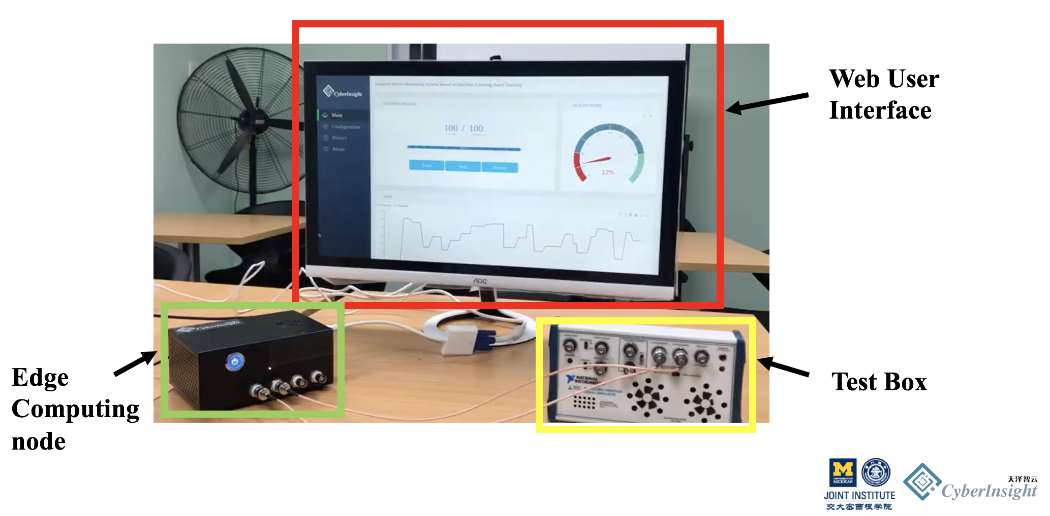
Final Design Description
Vibration on x, y axis ,Rotation Speed
Hardware System: An edge computing node
An industrial motor
Data Acquisition
(DAQ)
Raspberry Pi
Web UI
Software System
Batch training Motor Monitoring Algorithm
Flask
MQE
SOM
Figure 2: Morphological analysis of the project
Figure 4: Final Design
Presented by VE450 Team 17 Dec 12. 2018
Notes:
Hardware说法好还是edge。。好

Slide 13
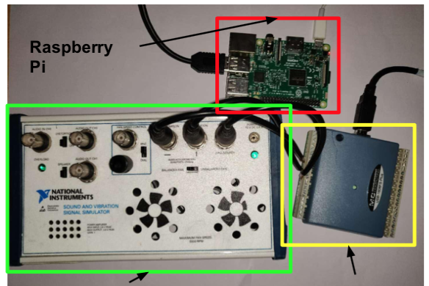
Final Design Description: Hardware system
Edge Computing Box:
Data Acquisition(DAQ):
Data collection tool
Raspberry Pi:
Edge calculation with batch training motor monitoring algorithm and Web services
Test Box:
Two motors inside that can simulate different conditions
Test Box
DAQ
Figure 4: Hardware System
Presented by VE450 Team 17 Dec 12. 2018

Slide 14
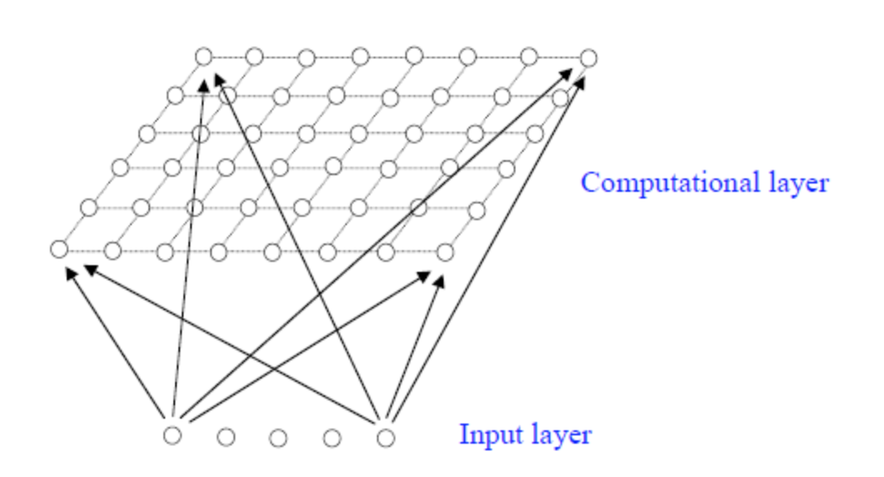
Final Design Description: Batch training motor monitoring Algorithm
Algorithm: Self-Organizing Map[5]
Create low-dimensional views of high-dimensional data
Input:
Vibration on x, y axis + Rotation speed
Output:
reduced dimension of input data
Test Statistic: Matching Quantization Estimation(MQE) [5]
Do classifications
Figure 5: Self Organizing Map
Presented by VE450 Team 17 Dec 12. 2018

Slide 15
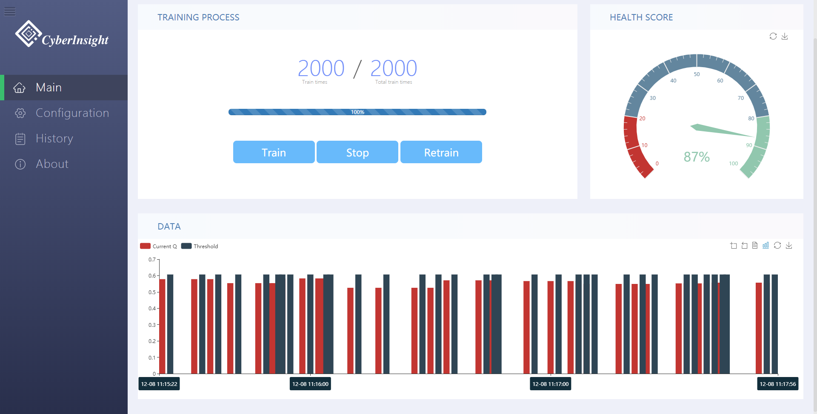
Final Design Description: Web UI
Training Process
Health Score
Real-Time Data： Current MQE value + Threshold
Figure 5: Web UI
Presented by VE450 Team 17 Dec 12. 2018

Slide 16
Prototype Video

Slide 17
Prototype Parameter Analysis
Engineering Specifications | Corresponding Parameter | Parameter Analysis
Training Rate: > 50 datum/s | Training Rate | Training rate per channel = 100*RPM/60 = 1.6~8.3kHz
Training Accuracy: > 95% | False Positive Rate | False Positive Rate = False Positive/Total Sample Number = False Positive/(False Positive + True Negative) = 98/100 = 98%
Response Time: < 800ms with 0 loss | Response Time | Response Time = Data Collecting Time + Processing Time + Communication Time = 200 ms +100 ms +200 ms = 500 ms
Table 6: Prototype parameter analysis
Presented by VE450 Team 17 Dec 12. 2018

Slide 18
Discussion
Customer Need | Our Design | Notes
Efficiency to train the model | Achieved
Adaptivity to different motors | Achieved | Proved in the video
High accuracy | Achieved
Remote control | Need real-world testing | Can only work in local
A Web user interface | Achieved | Proved in the video
Table 7:Discussion
Presented by VE450 Team 17 Dec 12. 2018

Slide 19
Conclusion
Health Monitoring System: Edge Batch Training Model
Embed machine learning model, SOM to the edge end
Simulate results on the Web UI
Our system is
Edge computing
Adaptive to different motors
High accuracy
Remote control
Presented by VE450 Team 17 Dec 12. 2018

Slide 20
Reference
[1] Borah, Samarjeet, Ranjit Panigrahi, and Anindita Chakraborty. "An Enhanced Intrusion Detection System Based on Clustering." Progress in Advanced Computing and Intelligent Engineering. Springer, Singapore, 2018. 37-45.
[2] Yao, Zhewei, et al. "Hessian-based Analysis of Large Batch Training and Robustness to Adversaries." arXiv preprint arXiv:1802.08241 (2018).
[3] Robinson, Melvin D., et al. "Properties of a Batch Training Algorithm for Feedforward Networks." Neural Processing Letters 45.3 (2017): 841-854.
[4] Buczak, Anna L., and Erhan Guven. "A survey of data mining and machine learning methods for cyber security intrusion detection." IEEE Communications Surveys & Tutorials 18.2 (2016): 1153-1176.
[5] Kohonen, Teuvo. "The self-organizing map." Proceedings of the IEEE 78.9 (1990): 1464-1480.
[6] Reynolds, Douglas. "Gaussian mixture models." Encyclopedia of biometrics (2015): 827-832.
[7] Holland, Steven M. "Principal components analysis (PCA)." Department of Geology, University of Georgia, Athens, GA(2008): 30602-2501.

Slide 21
Thank you! Q & A

